Slide 1
CS 5393 Final
Recurrent Neural Networks and Stock Prediction

Slide 2
Agenda
Project Overview
Models: LSTM vs GRU
Features
Activation Functions
Model Performance and Comparison
Applications and Key takeaways

Slide 3
Project Overview

Slide 4
Project Overview
In this project, I used recurrent neural networks, or RRNs, to predict NVIDIA stock prices
Each model was given data using yfinance, an open-source tool that uses Yahoo's API to retrieve stock information
Model performance evaluated using Root Mean Squared Error and Mean Absolute Error

Slide 5
Project Overview: Evaluation Metrics
Metric | What it measures | Trading Relevance
Root Mean Squared Error (RMSE) | Magnitude of large errors | Useful for risk management (i.e. preventing catastrophic predictions)
Mean Absolute Error (MAE) | Average prediction error | Tells traders the "expected slippage", or error, of the model when acting on predictions

Slide 6



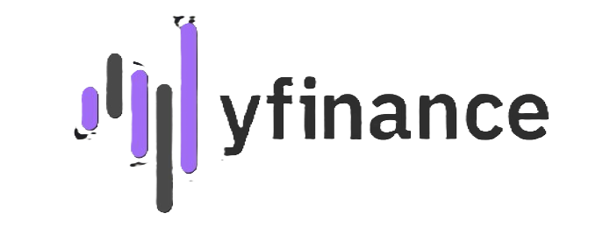
Project Overview: Tools

Slide 7
LSTM vs GRU Models

Slide 8
LSTM vs GRU Models
In this project, I trained both LSTM (Long Short-Term Memory) and GRU (Generated Recurrent Units) models
Differences in architecture:
LSTMs have separate memory cell, input, output, and forget gates
GRUs combine input and forget gates into an update gate, simplifying its structure

Slide 9
LSTM vs GRU Models
LSTM RNNs take longer to train and require longer computational times than GRU models
LSTMs can be more effective at handling long-term dependencies than GRUs
Both types of RRNs solve the vanishing gradient problem

Slide 10
Features

Slide 11
Features
Feature | Captures | RNN Benefit
Closing Price (Target) | Autoregressive Patterns | Used for time-series autoregression
SMA 50 | Short-Term Trends | Smooths noise
SMA 200 | Long-Term Trends | Smooths noise
Volume | Trade activity | Adds additional contextual information
Volume Change | Spikes in trade activity | Adds additional contextual information
14-Day Relative Strength Index | Overbought and Oversold stocks | Non-linear patterns for model to learn
Moving Average Divergence Convergence | Momentum | Non-linear patterns for model to learn

Slide 12
Activation Functions

Slide 13
Activation Functions: ReLU
Benefits of using ReLU for stock prediction:
Unlike Tanh or Sigmoid, ReLU does not saturate for positive values, mitigating the "vanishing gradient" problem
Improved computational efficiency over other methods
Other activation functions:
Activation Function | Potential Disadvantage
Sigmoid | Saturates for extreme values
Tanh | Computationally heavier than ReLU
Leaky ReLU | Computationally heavier than ReLU

Slide 14
Model Performance

Slide 15
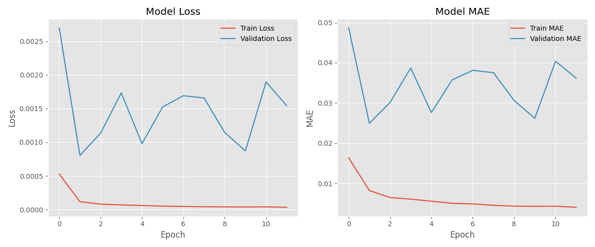
Performance: LSTM Loss

Slide 16
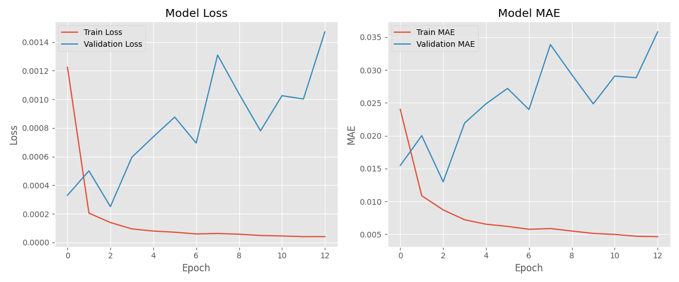
Performance: GRU Loss

Slide 17
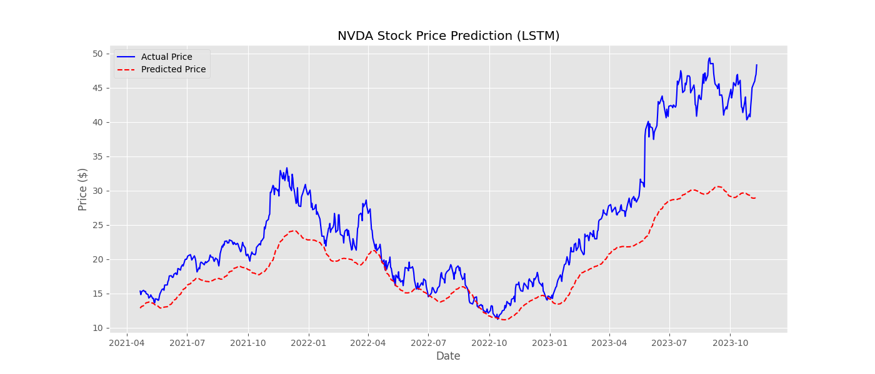
Performance: LSTM Prediction

Slide 18
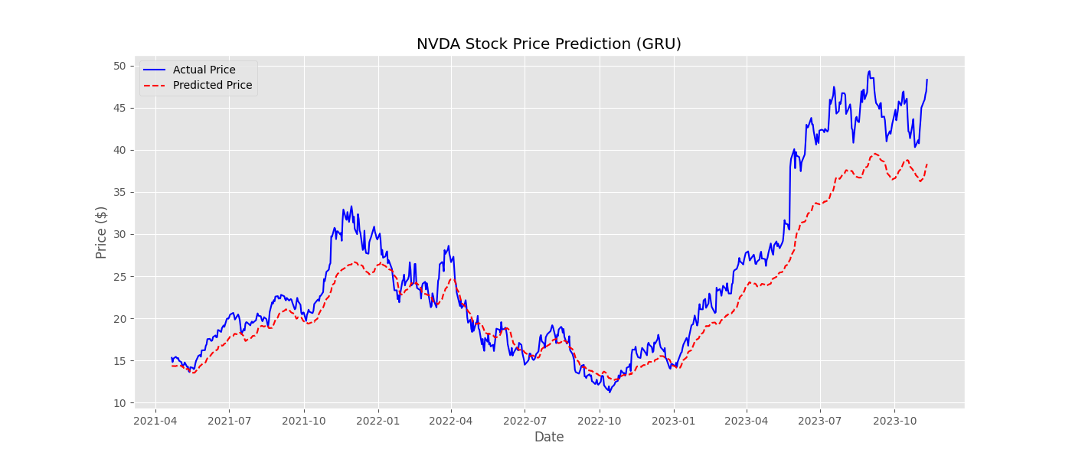
Performance: GRU Prediction

Slide 19
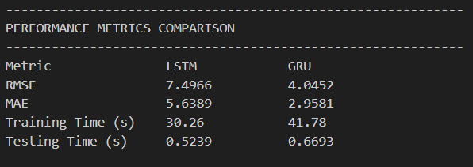
Performance: LSTM vs GRU

Slide 20
Key Takeaways and Applications

Slide 21
Conclusions: LSTM vs GRU
GRU outperformed the LSTM model on NVIDIA stock prediction
Why is this?
GRU can have comperable performance to LSTM on smaller datasets (Chung et al. (2014))
GRUs adapt to changes in data faster than LSTMs, and NVIDIA is a volitile stock

Slide 22
Conclusions: LSTM vs GRU
GRU was slower than LSTM
Why is this?
Early stopping: GRU was trained for more epochs than LSTM
GRUs adapt to changes in data faster than LSTMs, and NVIDIA is a volitile stock

Slide 23
Conclusions: Applications of my Model
Would I use my models in a real world-scenerio? No
Better models exist
In 2024 a group of computer scientists created a LSTM that predicted HFDC stock with a MAE value of 0.21 (Barua et al. (2024))
Transformers might create a more reliable model (long term)

Slide 24
Conclusions: Next steps
Additional Testing, hyper parameter tuning
Exploit NVIDIA's volitility with new features (Bollinger Band Width)

Slide 25
THANK YOU
Austin Carnline
Lcarnline@smu.edu

